Slide 1
Secure Data Hiding in Images using Steganography
CAPSTONE PROJECT
Presented By: Aditya Vishwakarma
Student Name : Aditya Vishwakarma
College Name & Department : Pune Vidyarthi Griha’s College of Science and Technology

Slide 2
OUTLINE
Problem Statement
Technology used
Wow factor
End users
Result
Conclusion
Git-hub Link
Future scope

Slide 3
Problem Statement
Traditional methods of encrypting text messages (e.g., encryption) are easy to identify.
Need a method of hiding secret messages in plain view without suspicion.
Steganography helps in the process of concealing text inside images without visible alteration.
This project enables users to hide and extract text securely from images with the assistance of Python.

Slide 4
Technology used
Programming Language: Python
Libraries Used:
tkinter - GUI for selecting images and buttons.
Pillow (PIL) – Image Processing.
NumPy – Handling pixel data.
fileddialog, messagebox – File selection and user selection.
Platforms: Works on Visual Studio Code, Windows.

Slide 5
Wow factors
What makes this project stand out from other project (Unique features) ?
1. Supports All Image Formats (PNG, JPG, BMP, TIFF, etc.) 2. Text is hidden inside images without visual changes 3. User-friendly GUI with easy "Select Image" & "Hide/Unhide" buttons 4. Fast & Efficient – No noticeable delay in hiding/unhiding text 5. Stealth Mode – Unlike encryption, attackers won’t suspect hidden text in images

Slide 6
End users
Who are the end users?
👨‍💻 Cybersecurity Experts & Ethical Hackers – For secure communication 🕵️ Whistleblowers & Investigative Journalists – To share sensitive information safely 🖥️ Software Developers – As a feature in secure applications 🔐 Government & Defense Personnel – For classified data transmission 📚 Academicians & Researchers – For studying steganographic techniques

Slide 7
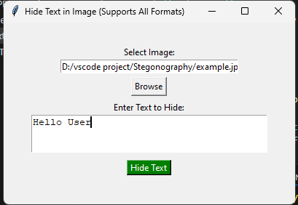
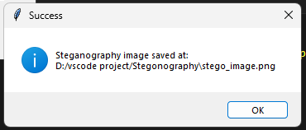
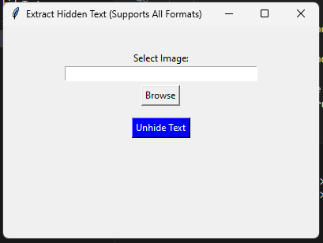
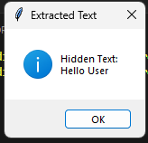
Results

Slide 8
Conclusion
The project successfully hides and extracts text from images using LSB (Least Significant Bit) Steganography.
Provides a secure, non-detectable way of sharing sensitive information.
The user- friendly interface makes it accessible for non-technical users.
Unlike traditional encryption, this method does not raise suspicion since the image looks unchanged.

Slide 9
GitHub Link
GitHub Repository: https://github.com/cyberfortify/AICTE_Steganography

Slide 10
Future scope(optional)
Enhancements for Better Security
AES-Encrypted Steganography – Encrypt the hidden text before embedding.
Hiding in Audio/Video – Extend the concept beyond images.
Mobile App version – Implement it for Android & IOS.
AI-Based Image Modification Detection – Detect if an image has hidden data.
Cloud-Based Secure Steganography Service – Secure image-Based communications over the web.

Slide 11
THANK YOU

